Slide 1
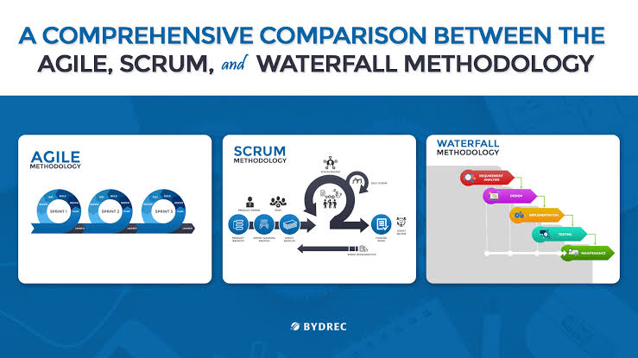

Agile & Scrum Methodology

Slide 2
Agenda
What is Agile Methodology and how organizations can benefit by following this approach?
Importance of SDLC
Traditional Development Model: Waterfall Model
Introduction to Agile Model
Waterfall Model Vs Agile
Agile Manifesto
How Sprint Execution works?

Slide 3
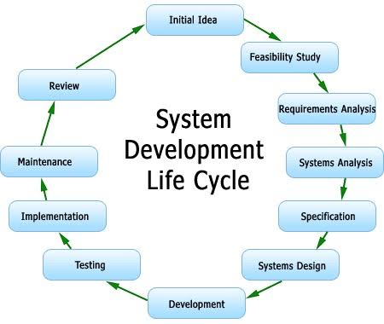

Slide 4
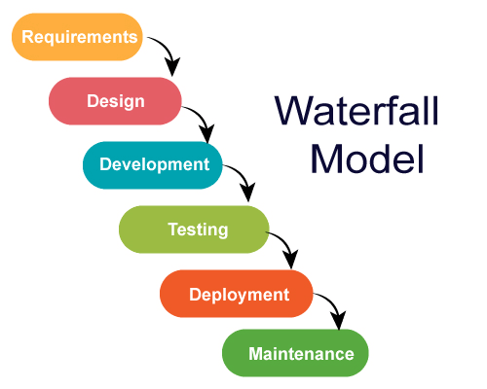

Slide 5
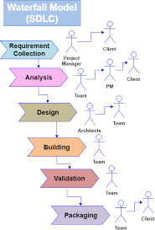

Slide 6
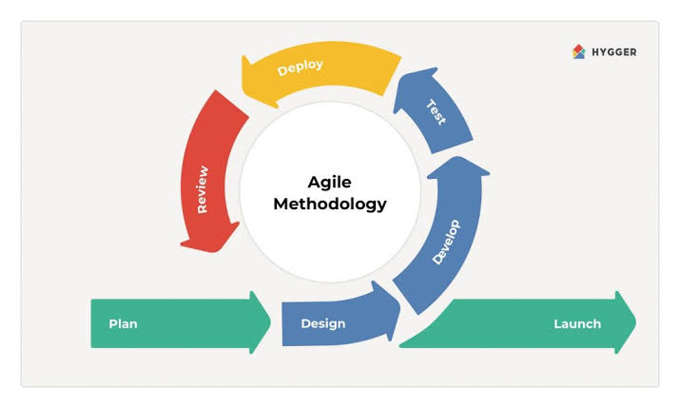
Agile Methodology

Slide 7
Agile is a software development methodology to build a software incrementally using short iterations of 1 to 4 weeks so that the development is aligned with the changing business needs.
It distributes the software with faster and fewer changes.
The single-phase software development takes 6 to 18 months. In single-phase development, all the requirement gathering and risks management factors are predicted initially.
The agile software development process frequently takes the feedback of workable product. The workable product is delivered within 1 to 4 weeks of iteration.

Slide 8
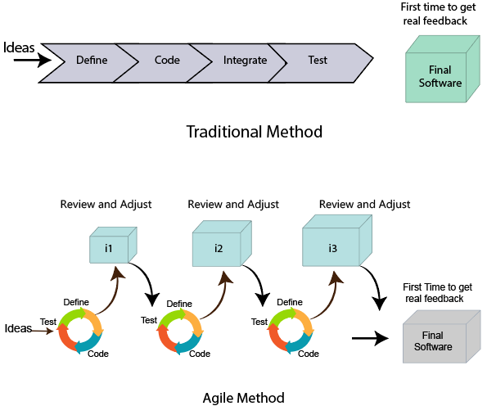

Slide 9
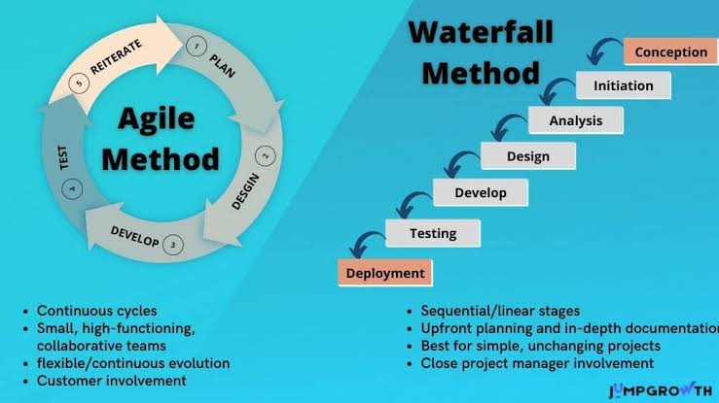

Slide 10
Roles in Agile
There are two different roles in a Agile methodology. These are the Scrum Master and Product Owner.
1. Scrum Master
The Scrum Master is a team leader and facility provider who helps the team member to follow agile practices, so that the team member meets their commitments and customers requirements. The scrum master plays the following responsibilities:
They enable the close co-operation between all the roles and functions.
They remove all the blocks which occur.
They safeguard the team from any disturbances.
They work with the organization to track the progress and processes of the company.

Slide 11
They ensure that Agile Inspect & Adapt processes are leveraged correctly which includes
Planned meetings
Daily stand-ups
Demo
Review
Retrospective meetings, and
Facilitate team meetings and decision-making process.

Slide 12
2. Product Owner
The Product Owner is one who runs the product from a business perspective. The Product Owner plays the following responsibilities:
He defines the requirements and prioritizes their values.
He sets the release date and contents.
He takes an active role in iteration and releasing planning meetings.
He ensures that the team is working on the most valued requirement.
He represents the voice of the customer.
He accepts the user stories that meet the definition of done and defined acceptance criteria.

Slide 13
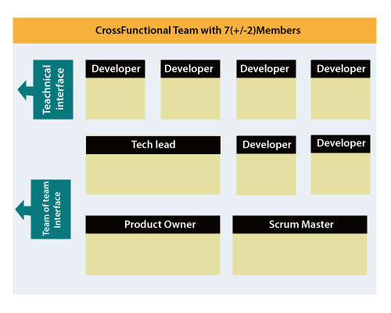
Cross-functional team

Slide 14
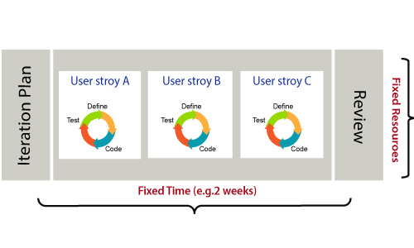
How an Agile Team plan their work?

Slide 15
What is a user requirement?
Point
A Point defines how much a team can commit. A point usually refers to 8 hours. Each story is estimated in points.
Capacity
Capacity defines how much an individual can commit. Capacity is estimated in hours.
What is a User Story?
A user story is a requirement which defines what is required by the user as functionality. A user story can be in two forms −
As a <User Role> I want <Functionality> so that <Business Value>
In order to <Business value> as a <User Role> I want <Functionality>
During release planning, a rough estimate is given to a user story using relative scale as points. During iteration planning, the story is broken down into tasks.

Slide 16
Relation between User requirement and Task
User requirement talks about what is to be done. It defines the needs of users.
Task talks about how it is to be done. It defines how functionality is implemented.
User requirements are implemented by tasks. Every requirement is gathering as the task.
User requirement is divided into different tasks when it is planned in current iteration.
User tasks are estimated in hours based, generally it is between 2 to 12 hours.
Requirements are validated using acceptance test.

Slide 17
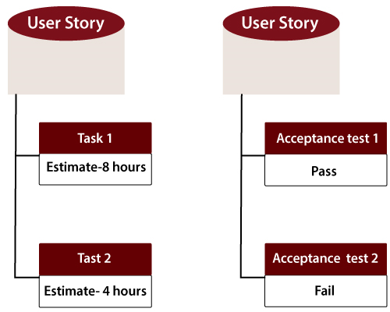

Slide 18
When the requirement is completed
The Agile team decides the meaning of task done. There may be different criteria for it:
When the entire task (development, testing) are completed.
When all the acceptance tests are running and are passed.
When no defects found.
Product owner has accepted the requirement.
When the software product is delivered to the end user.

Slide 19
What is Software Acceptance Criteria?
Acceptance Criteria is defined as the functionality, behavior, and performance required by a product owner.
It defines what is to be done so that the developer knows when a user requirement is complete.

Slide 20
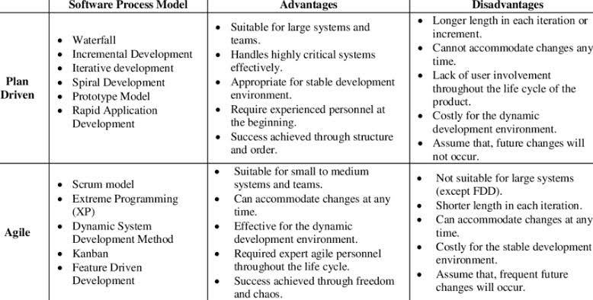

Slide 21
Agile Manifesto
The Twelve Principle of Agile Manifesto
Customer Satisfaction:
Welcome Change:
Deliver the Working Software:
Collaboration:
Motivation:
Face-to-face Conversation:
Measure the Progress as per the Working Software:
Maintain Constant Pace:
Monitoring:
Simplicity:
Self-organized Teams:
Review the Work Regularly:

Slide 22
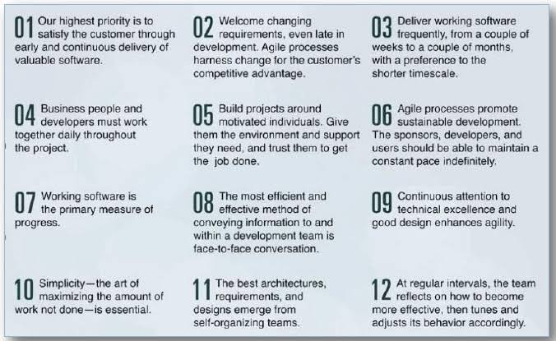

Slide 23
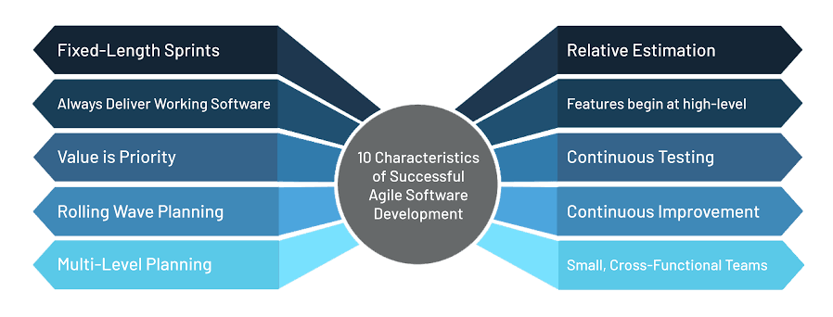
Agile - Characteristics

Slide 24
Agile - Daily Stand-up
A daily stand-up is a daily status meeting among all team members and it is held roughly for 15 minutes.
Every member has to answer three important questions −
What I did yesterday?
What I'll do today?
Any impediment I am facing.../ I am blocked due to...
Daily stand-up is for status update, not for any discussion. For discussion, team members should schedule another meeting at a different time.
Participants usually stand instead of sitting so that the meeting gets over quickly.

Slide 25
Who Attends a Stand-up?
The scrum master, the product owner, and the delivery team should attend the stand-up on a daily basis.
Stakeholders and Customers are encouraged to attend the meeting and they can act as an observer, but they are not supposed to participate in stand-ups.
It is the scrum master's responsibility to take note of each team member's queries and the problems they are facing.

Slide 26
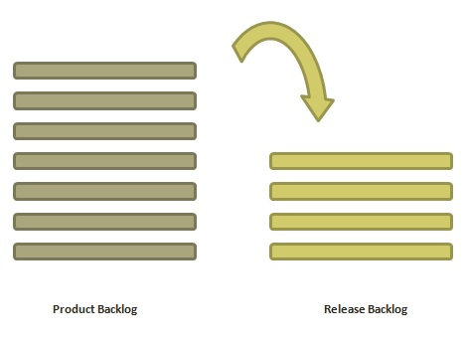
Agile - Release Planning
The purpose of release planning is to create a plan to deliver an increment to the product. It is done after every 2 to 3 months.

Slide 27
Who is Involved?
Scrum Master − The scrum master acts as a facilitator for the agile delivery team.
Product Owner − The product owner represents the general view of the product backlog.
Agile Team − Agile delivery team provides insights on the technical feasibilities or any dependencies.
Stakeholders − Stakeholders like customers, program managers, subject matter experts act as advisers as decisions are made around the release planning.

Slide 28
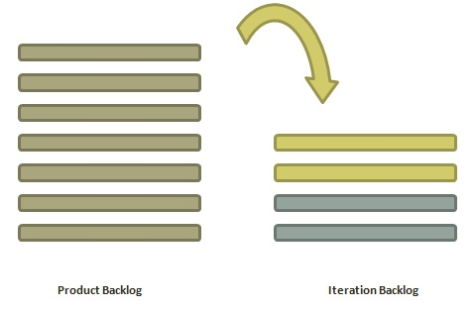
Agile - Iteration Planning
The purpose of iteration planning is for the team to complete the set of top-ranked product backlog items. This commitment is time boxed based on the length of iteration and team velocity.

Slide 29
Who is Involved?
Scrum Master − The scrum master acts as a facilitator for the agile delivery team.
Product Owner − The product owner deals with the detailed view of the product backlog and their acceptance criteria.
Agile Team − Agile delivery defines their tasks and sets the effort estimates required to fulfil the commitment.

Slide 30
Agile - Product Backlog
A product backlog is a list of items to be done. Items are ranked with feature descriptions. In an ideal scenario, items should be broken down into user stories

Slide 31
Why Product Backlog is Important?
It is prepared so that estimates can be given to each and every feature.
It helps in planning the roadmap for the product.
It helps in re-ranking the features so that more value can be added to the product.
It helps in determining what to prioritize first. Team ranks the item and then builds value.

Slide 32
What is Scrum?
Scrum is a framework that helps agile teams to work together.
Using it, the team members can deliver and sustain the complex product.
It encourages the team to learn through practice, self-organize while working on the problem.
Scum is a work done through the framework and continuously shipping values to customers.
It is the most frequent software that is used by the development team.
Its principle and lessons can be applied to all kinds of teamwork. Its policy and experiences is a reason of popularity of Scrum framework.
The Scrum describes a set of tools, meetings, and roles that help the teams structure. It also manages the work done by the team

Slide 33
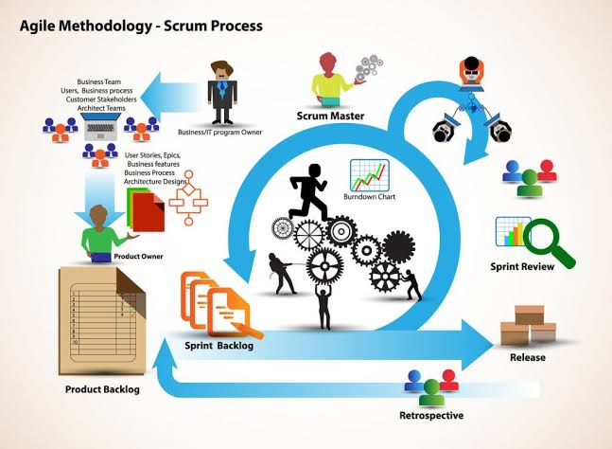

Slide 34
What are sprints?
With scrum, a product is built in a series of repetition called sprints.
It breaks down big complex projects into bite-size pieces.
It makes projects more manageable, allows teams to ship high quality, work faster, and more frequently.
The sprints give them more flexibility to adapt to the changes.
Sprints are a short, time-boxed period for Scrum team that works to complete a set amount of work.
Sprints are the core component of Scrum and agile methodology.
The right sprints will help our agile team to ship better software.

Slide 35
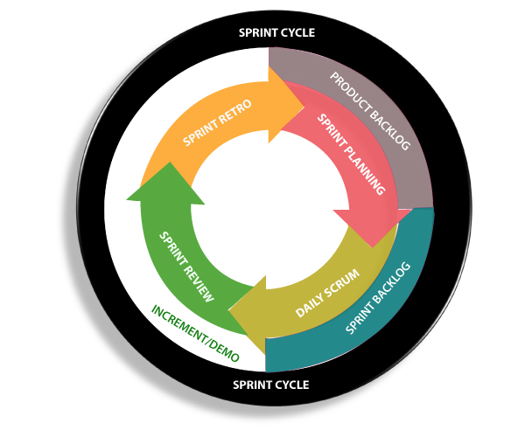

Slide 36
What is sprint plan?
Sprint plan is an action in Scrum that kicks off the sprint.
The primary purpose of sprint plan is to define what can deliver in the sprint.
It also focuses on how the work will be achieved.
It is done in combination with the whole Scrum team members.
The sprint is a set of the period where all the work to be done.
Before we start the development, we have to set up the sprint.
We need to describe how long time is required to achieve the sprint goal and where we are going to start.

Slide 37
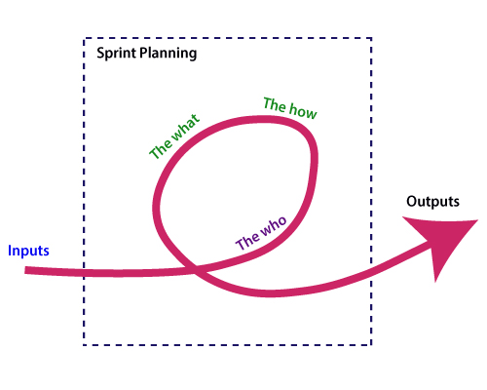
Factors affecting Sprint planning

Slide 38
What is the product backlog?
A product backlog is a registered list of work for the development team.
It is driven from the roadmap and its requirements.
The essential task is represented at the top of the product backlog so that the team member knows what to deliver first.
The developer team doesn't work through the backlog from the product owner's side and product owner doesn't push the work to the developer team.
The developer team pulls work from the product backlog.

Slide 39
Backlog starts with the two "R"s
The fundamental product backlog is provided by a team's roadmap and requirements.
Roadmap repetition breaks down into several epics, and each epic will have several requirements and user stories.
The product owner organizes each of the customer stories into a single list.
This story is organized for the development team. The product owner chooses to deliver first complete epic.

Slide 40
What is Kanban?
Kanban is a popular framework which is used to implement agile software development.
It takes real time communication of capacity and complete transparency of work.
The work items are represented in a kanban board visually, allowing team members to see the state of every piece of work at any time.

Slide 41
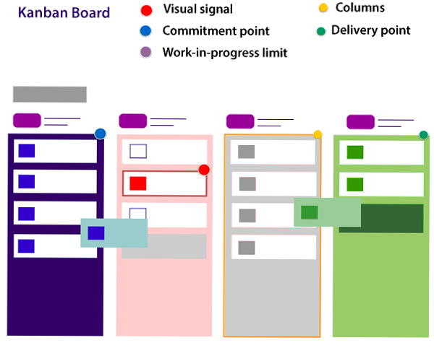

Slide 42
Agile Tools
JIRA Agile -Jira is a tool developed by Australian Company Atlassian. It is used for issue tracking, bug tracking, and project management. The bugs and issues are related to your software and Mobile apps. The Jira dashboard consists of many useful functions and features. This function and features make secure handling of issues.

Slide 43
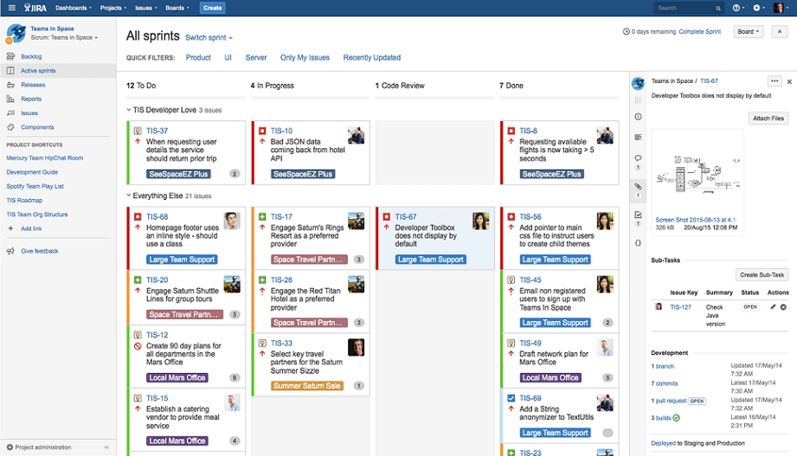

Slide 44
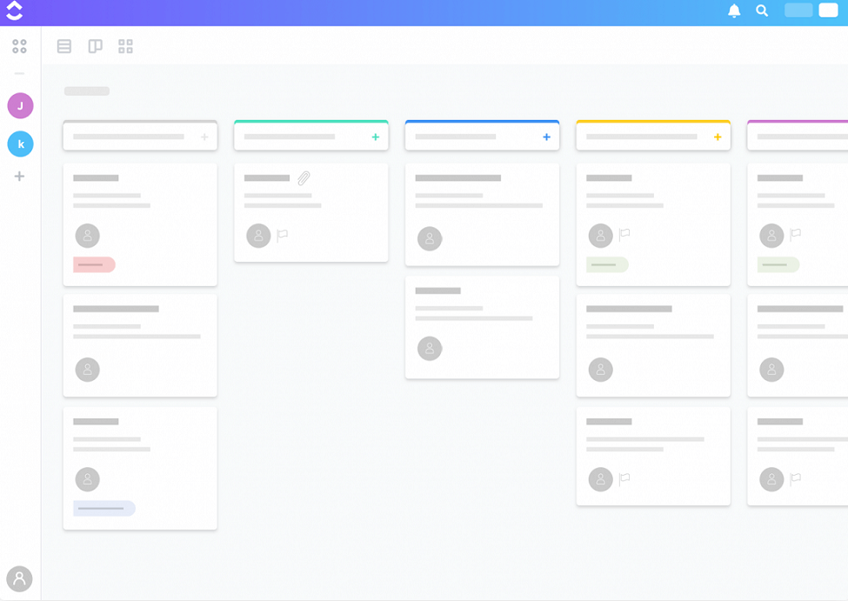
ClickUp
ClickUp

Slide 45
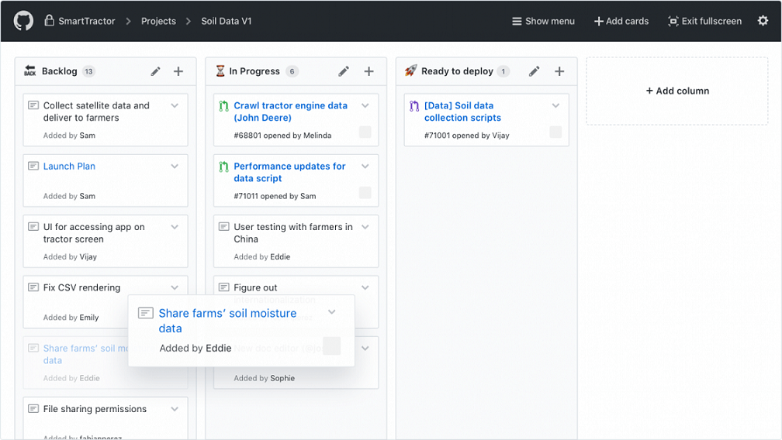
Github

Slide 46
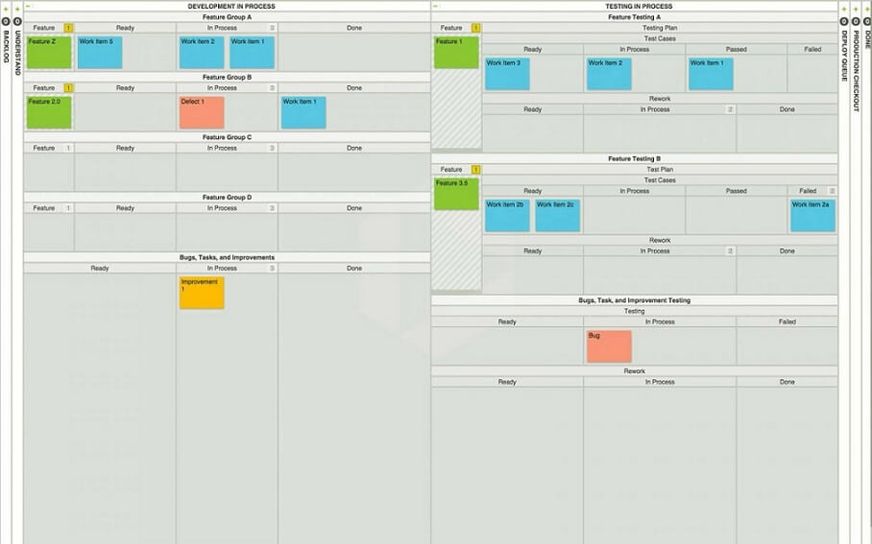
LeanKit

Slide 47
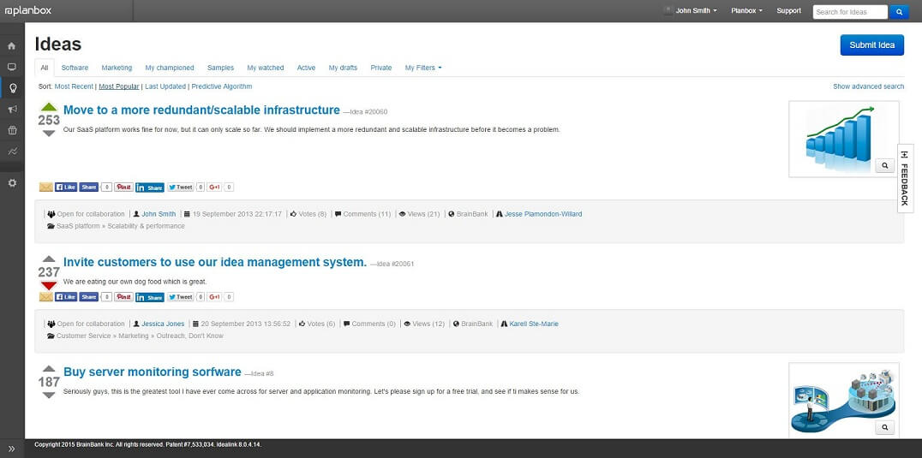
Planbox

Slide 48
